Slide 1






Give 2011
Give with Passion
Vaibhav Bhandari
About Teach for India
About Asha
Success Stories
Microsoft Connection
Financials
How you can help
www.vitraag.com
twitter.com/vaibhavb
facebook.com/vitraag
Notes:
TODO: get Asha logo and theme

Slide 2
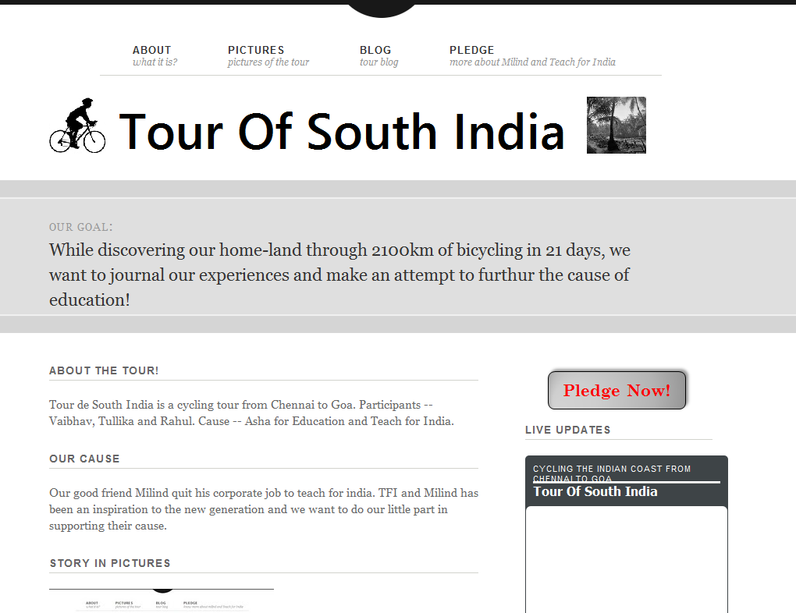
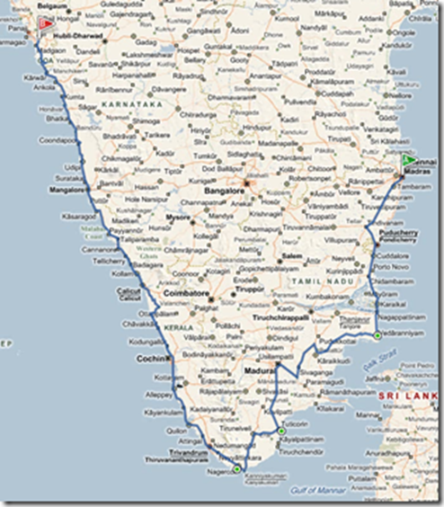

Slide 3
Teach For India
MSFT Give Details
Search for -- "Akanksha Fund Inc“
In the note add -- "Please earmark the funds towards "Teach For India - Milind Nagda's class"."

Slide 4
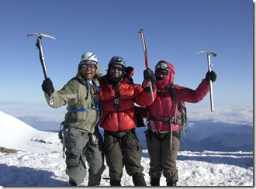
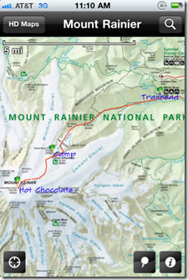
Asha

Slide 5
About Asha
Our Mission:
To catalyze socio-economic change in India through the education of underprivileged children
Core Values:
100% volunteer driven
100% of donations goes to projects in India
Non-political and non-religious
Transparent and accountable
Flat democratic organizational structure
Notes:
Asha-Seattle is a chapter of Asha for Education, a non-profit voluntary organization dedicated to socio-economic change in India mainly using the medium of education. Our goal is to also address whenever possible other development and human issues such as women's issues, health-care and related issues. Asha was started in 1991 in Berkeley. The Seattle chapter was formed in December 1994 by a diverse group of students and professionals from the Seattle area (for a first-hand recollection, please go here). Asha is a secular organization welcoming volunteers irrespective of religion, race, gender or caste. We have no religious or political affiliation. The aim of the group is to mobilize the local population to collectively support and provide assistance in different forms to groups working at the grass roots in India. Our volunteer meetings are open to anyone interested in social and developmental issues.
Notes:
Talk about why we are different
Transparency: All financials are publically accessible. Meetings are open to all
Accountability: Rigorous process to ensure partner credibility and effectiveness. Close engagement and periodic follow-up
Flat organizational structure: All decisions are voted upon and everyone’s vote is equal within chapter. Asha wide decisions are voted upon as well with every chapter getting it’s say.
Volunteer driven: No paid staff. All the work is done by volunteers.
Zero Overhead: Admin expenses are bourne by volunteers. (0.9% admin exp, 0.2% fundraising exp, 98.7% program exp)
Focus on empowerment: Do not just focus on project’s immediate needs but also on their growth and self-sustenance. We also look at community and big-picture issues.

Slide 6
Asha Seattle & Asha Worldwide
Asha World wide
Started in 1991 in Berkeley
67 chapters world-wide
Seattle Chapter
Started in 1994
76 project partners since inception
Supported more than 400 Project Partners since inception
Largest Asha Chapter
About 2.5 million disbursed in last 3 years
Close to 9 million Funds disbursed in last 3 years
Notes:
Asha Seattle has more than 40 active projects.
67 chapters world-wide (as of June 2011)

Slide 7
What we do
Support projects in India
Raise Awareness in the local community
Advocate for policy change
Outreach & Fundraising
Examples: Right to education, Right to information
Giving Campaign
Endurance events – run / bike / climb
Concerts and other cultural events
Talks, film screenings
40+ projects all over India
Education, healthcare, gender and livelihood issues
Workshops, meetings
Policy push for large scale change
Notes:
Our emphasis is on the following:
Form close partnerships with groups in India. We attempt to maintain regular contact and visit the groups we work with to form a stable long term relationship.
To maximize effectiveness of our efforts we seek to support groups in rural and economically poor areas.
Provide assistance in different ways such as financial, material and technological support to the groups in India.
We strive to learn about and disseminate information on different social issues faced by the affected people in India.
We organize talks by different grass roots activists in India in the Seattle area.
Partnering with NGO’s/NPO’s
identify projects, review needs, support and follow-up
Raising awareness
talks, documentary screenings, workshops, meetings, e-mails
Sikshana & Public Education System – E S Ramamurthy
Creative visions for the future of learning – Jane Sahi
Getting the Government to deliver quality education – Balaji Sampath
Advocacy
right to education, right to information, review of education material
Avehi Abacus – reviewed educational material going out to 900 government schools
Outreach & Fund raising
Giving Campaign, Wheels of change, Miles for smiles, Climb for Asha,
Concerts, Golf Tournament, Exhibition at SAAM

Slide 8
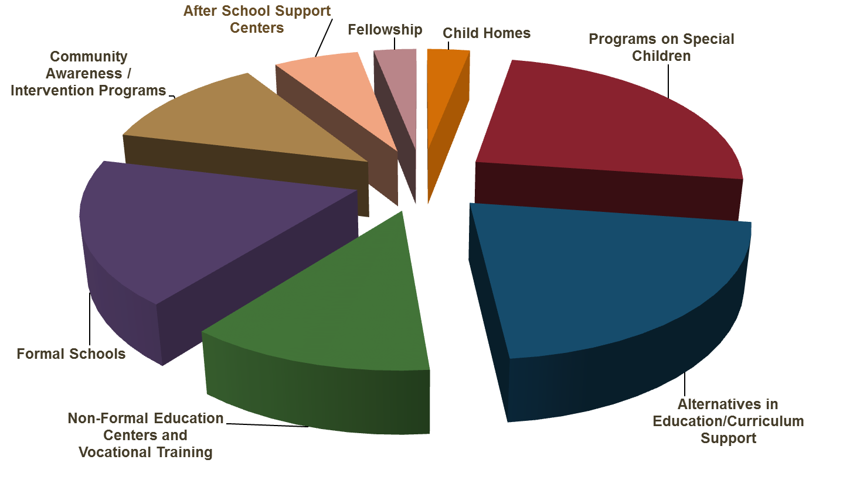
Range of projects
Notes:
We focus not just on school education, but also on non-formal education, after-school support, community awareness programs etc.
Aseema is supported by Asha for Education: Salim & Latika from the movie Slumdog Millionaire went to a school run by Aseema
The funds support building schools, providing for food, books, stationary, uniforms, teacher salaries, technology and other administrative costs

Slide 9
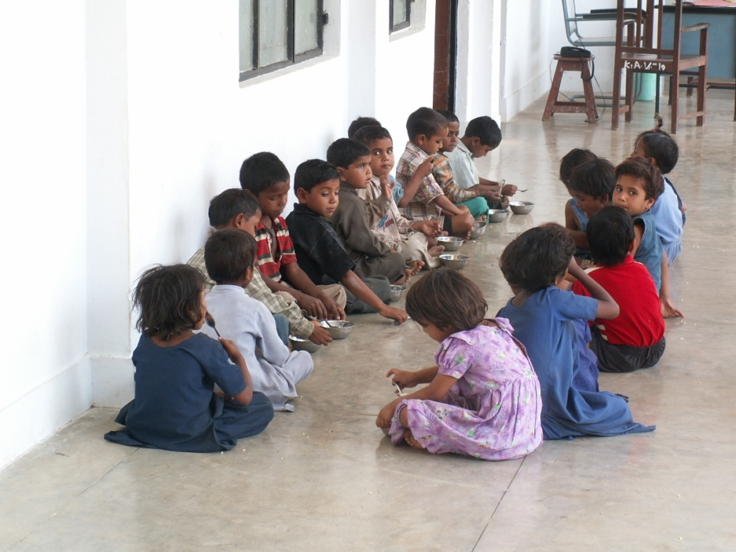
Project spotlight: Bhoomiheen Sewa Samiti
Set in a very feudal social context
Catering to Dalit landless laborers
19 years of struggle resulted in recent land allocation
Primary to middle school
Free health care
Food for the pre-primary kids

Slide 10
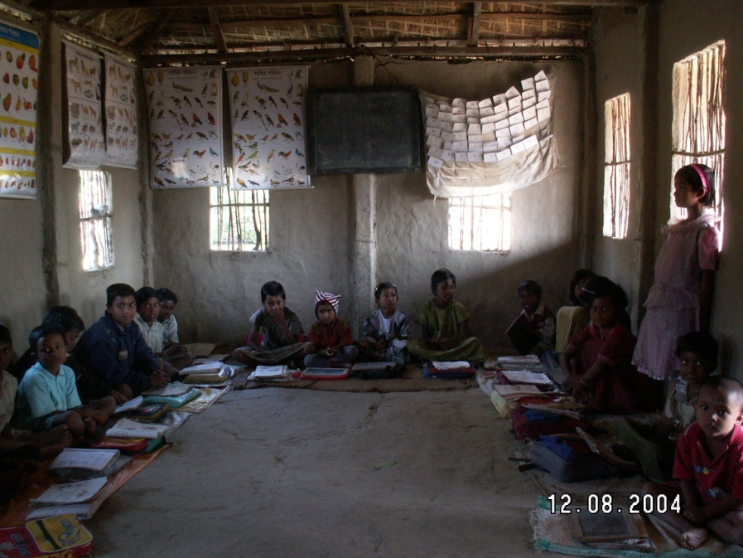
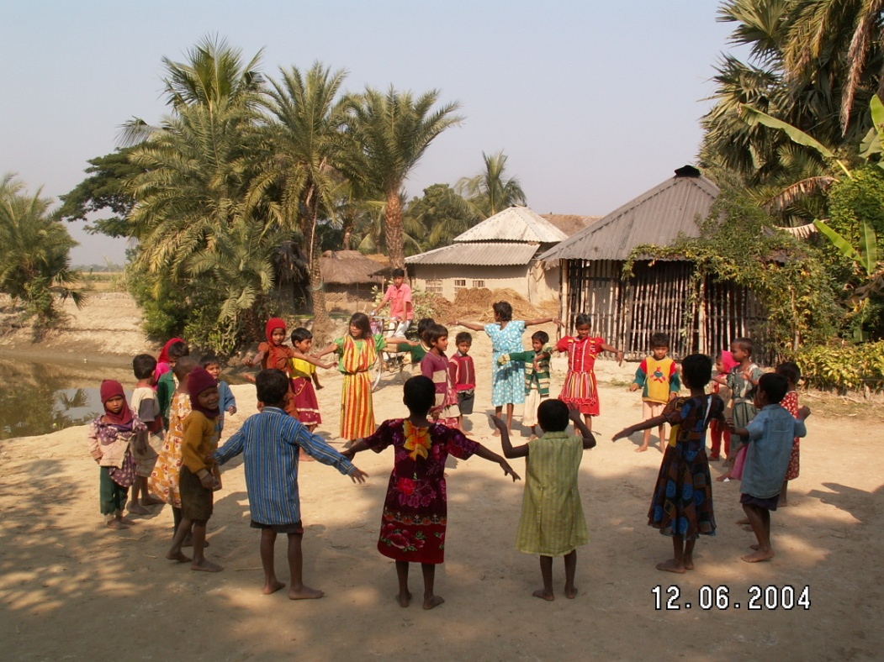
Project spotlight: Champa Mahila Society
Spread over 30 villages
Children ages 3-18
Formal Schools
Health Care
Early Childhood Education
Special Children

Slide 11
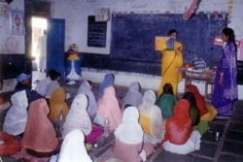
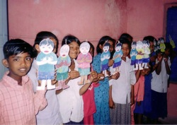
Project spotlight: AVEHI Abacus
Strengthening the quality and content of education
Working in government schools
900 municipal schools in Mumbai
Sangati curriculum:
Links to life outside school
Build skills of thinking, analyzing and making choices
Promote harmony and celebrate diversity

Slide 12
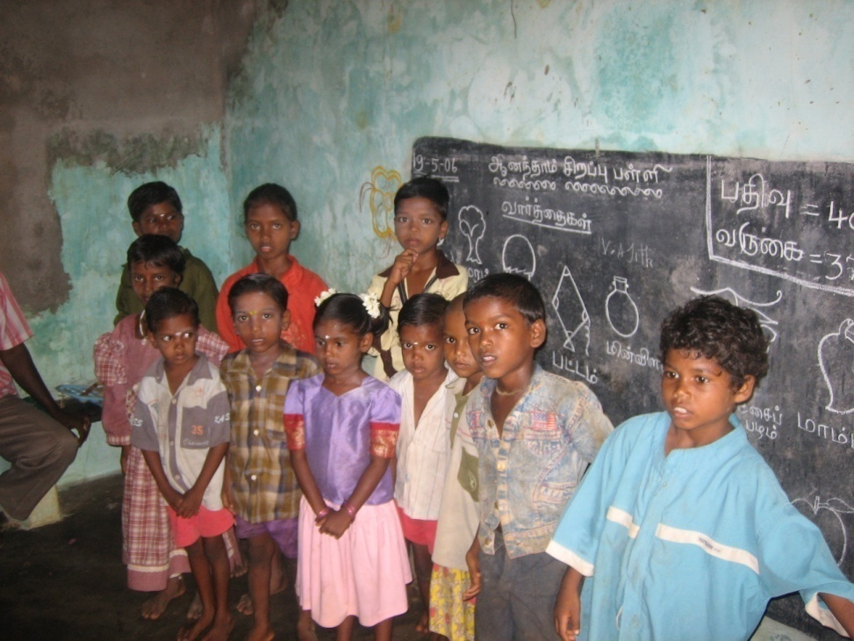
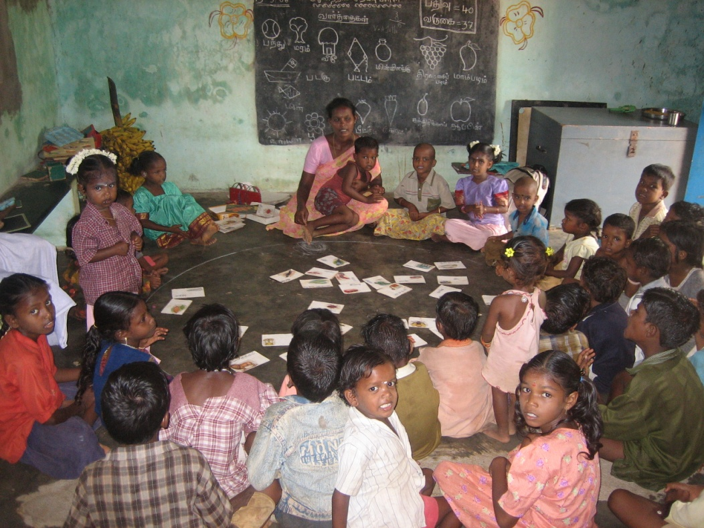
Project spotlight: Bharathi Trust
Empowering Irula Tribal communities
Spread over more than 60 villages
Resource centers, schools, Liaisoning with government. etc.
Recent highlights:
Freeing hundreds of bonded laborers
Tsunami rehabilitation

Slide 13
Our Financials
Notes:
2011 income and expense numbers are ‘estimated’

Slide 14
Asha Seattle in Microsoft
Employee Volunteers: 50+
Employee donors: 700+
Volunteer time matching: over 1600 hours volunteered in 2009 by Microsoft employees for Asha
Give Campaign: Asha Seattle has been ranked among the top 25 organizations consistently in Microsoft’s Give list of organizations for the last 5+ years
Notes:
Year over year, the number of hours volunteered has gone up. In 2008, we had 1500 hours recorded, in 2009, it’s over 1600 hours.
It takes time and effort to run a 100% volunteer driven organization. Microsoft employees have contributed to the success of the Seattle chapter and in helping make a difference.
Give ranking: both in terms of number of individual donors and total amount of funds raised

Slide 15


How YOU can help
Donate – support a child, a project, an event
Help us outreach & spread the word
Volunteer – be the change
twitter.com/ashaseattle
facebook.com/ashaseattle
Notes:
Over the years, we have learnt, building a relationship with the project partners, volunteers & donors has helped us achieve greater success. Help spread the word about our work.
Join us in our fundraising efforts – sponsoring our events, joining us for Golf Tournaments, Climb for Asha, Miles for Smiles, Wheels of Change – a lot of avenues if you would like to be directly involved.
Become a Friend of Asha : http://www.ashanet.org/seattle/friendsofasha.php
If you have children, there is a wonderful opportunity to help involve juniors with our Junior Asha group – Junior Asha has raised more than 800$ this year alone!
If you would like to meet with one of the volunteers, here’s a few aliases to contact :
BPathak
SrijanC
PalaniS
AanchalS
FarhanAh
KalpanaS

Slide 16

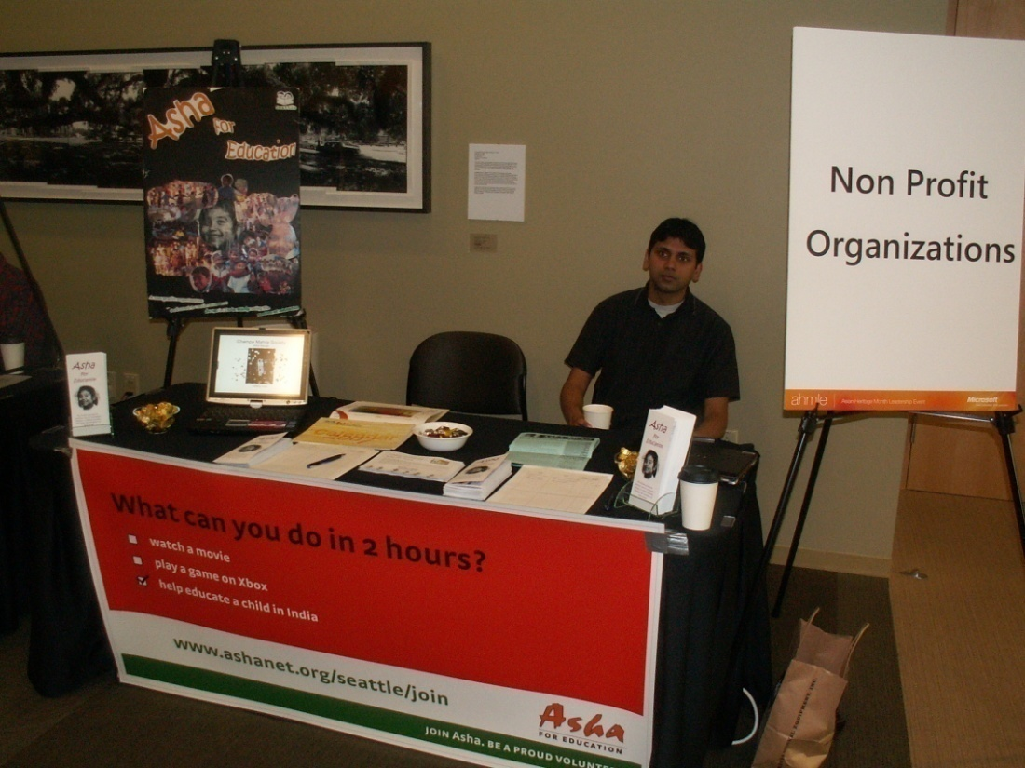
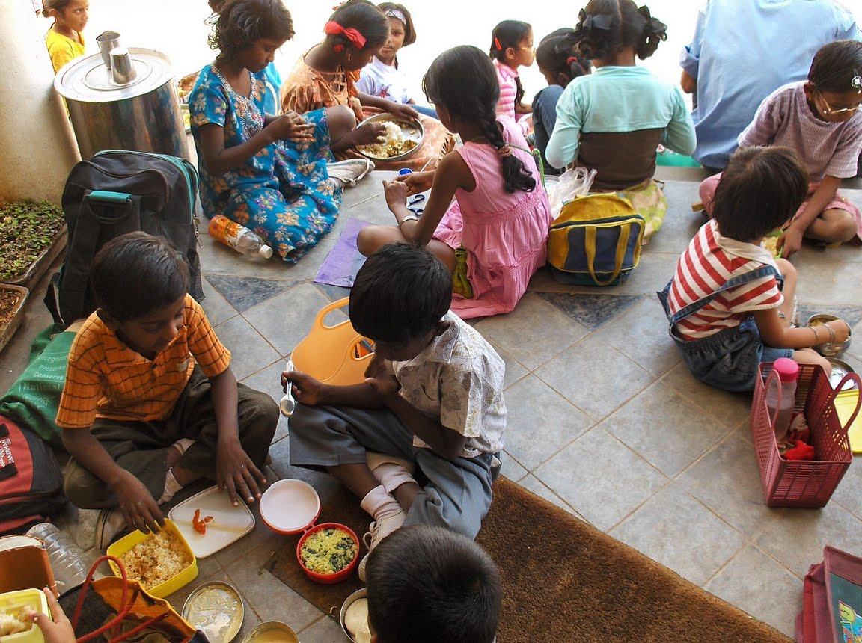

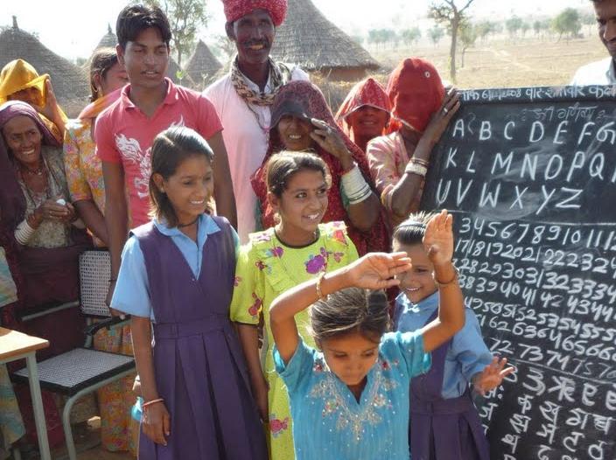
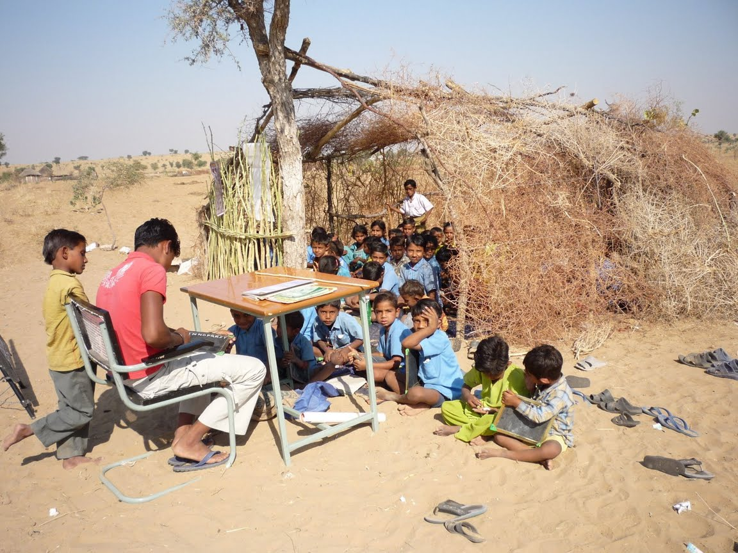
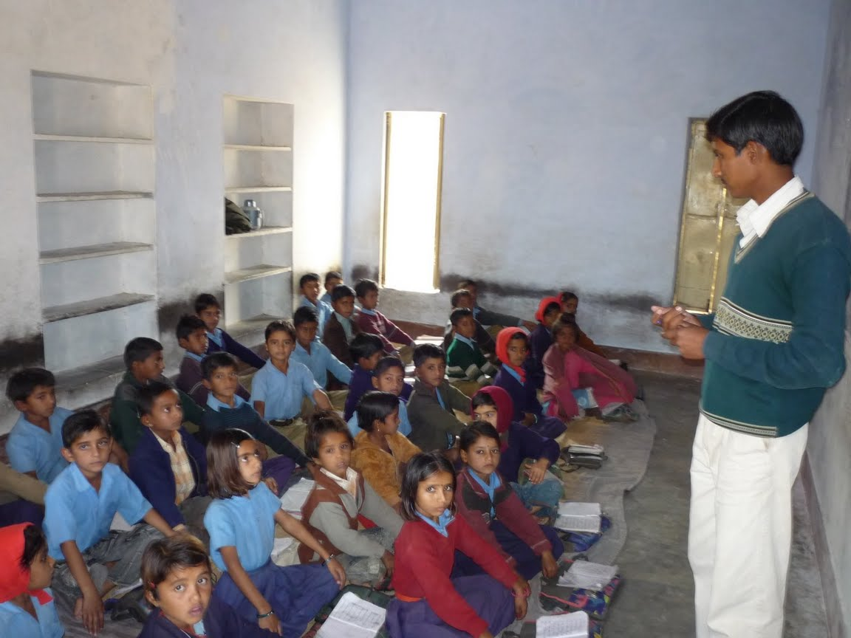
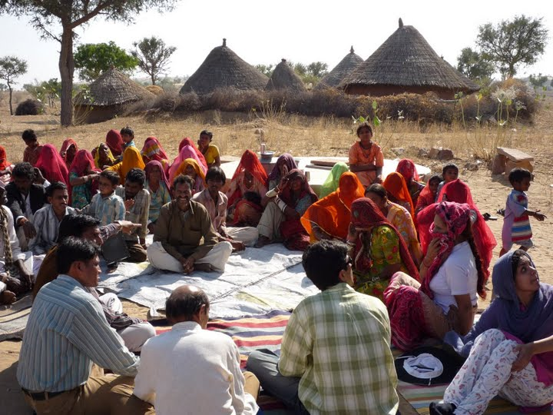
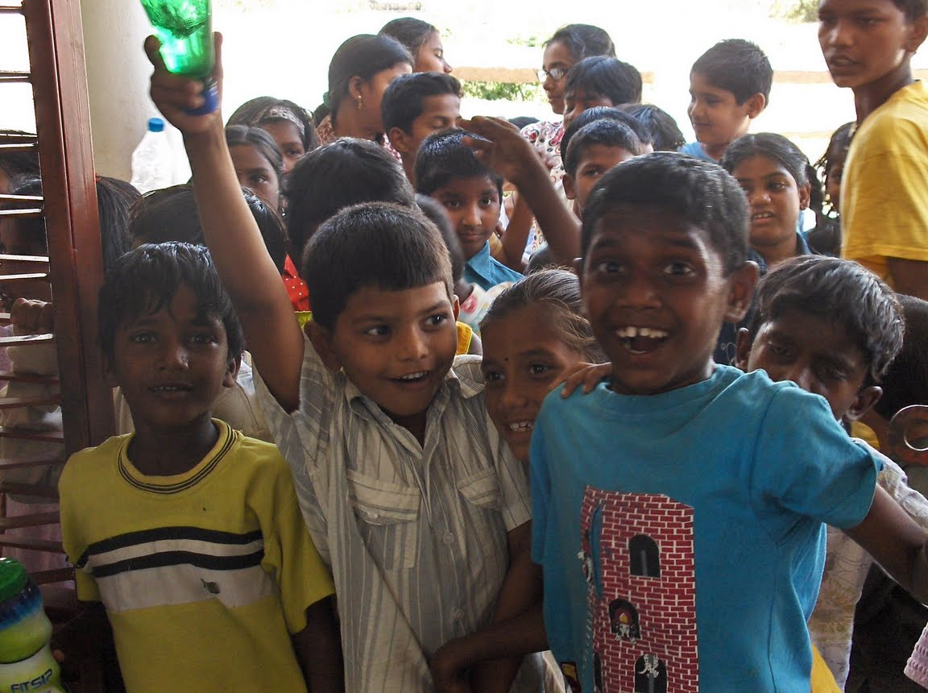
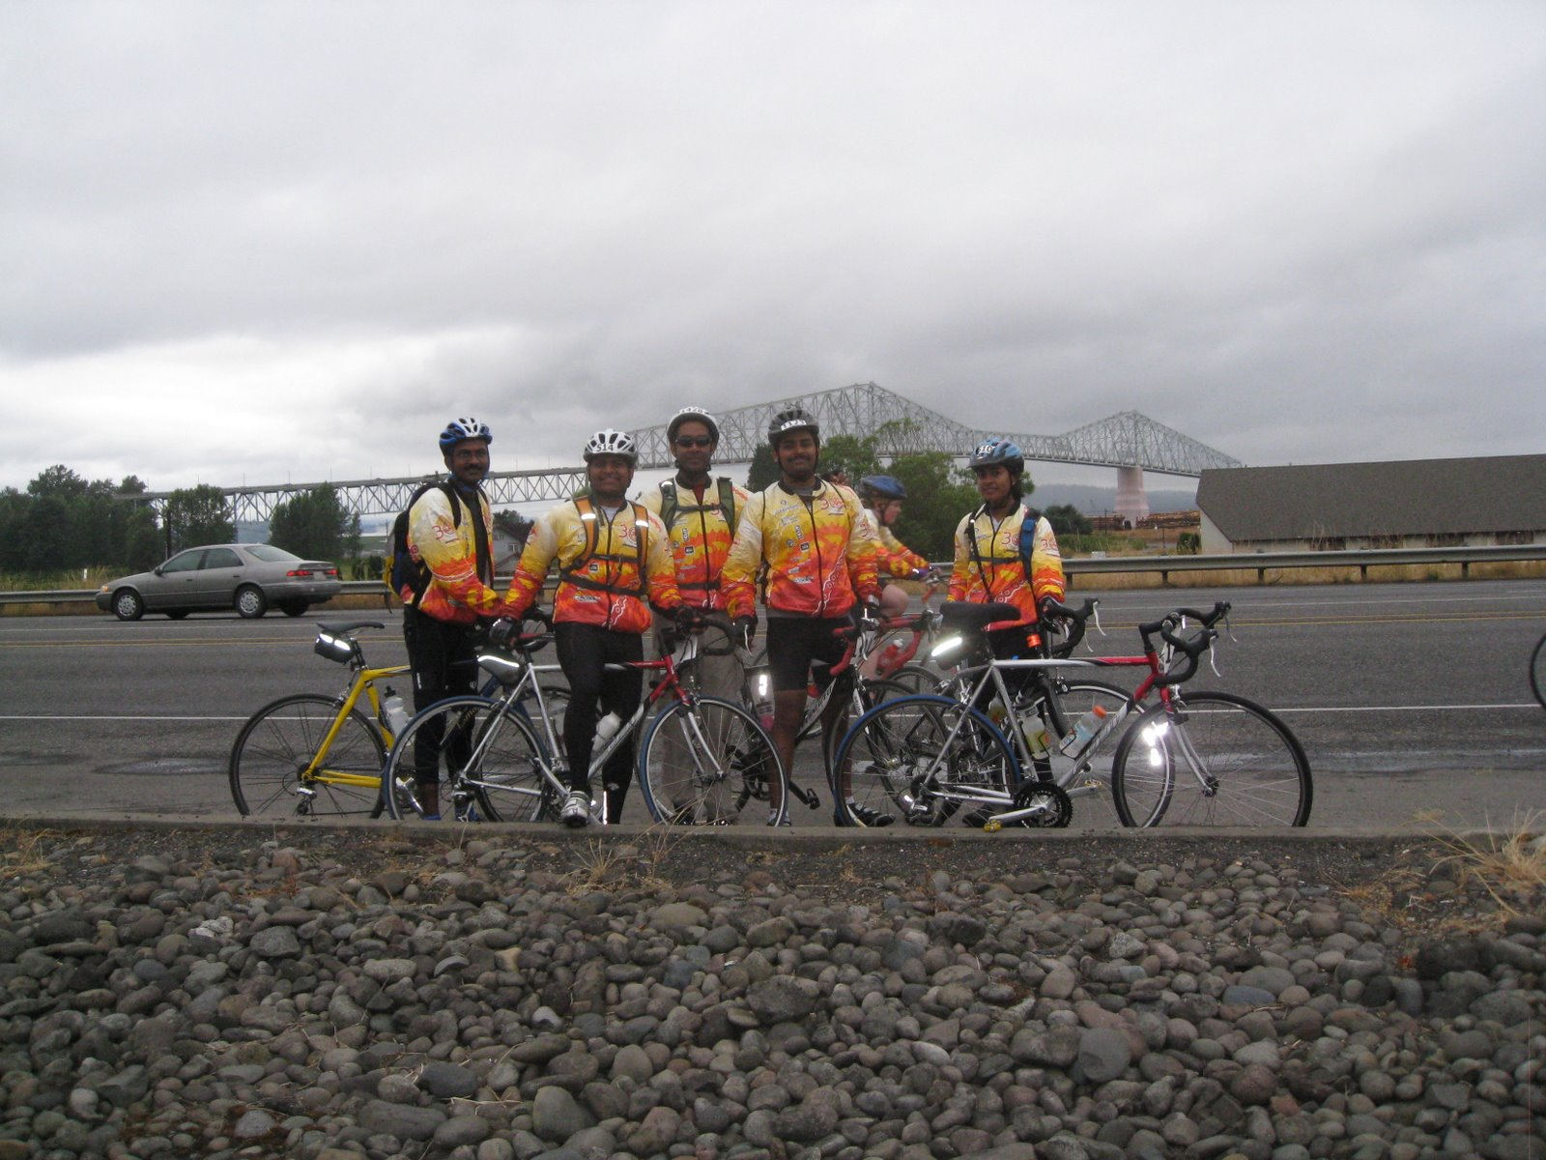
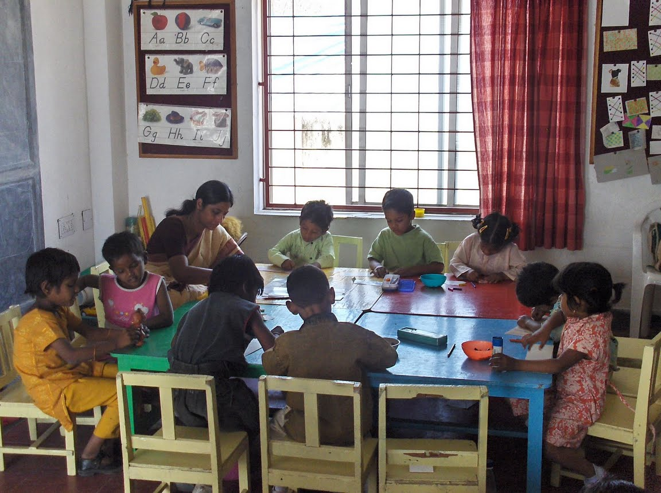
Thank you!

Slide 17

Give 2011
About Asha
Success Stories
Microsoft Connection
Financials
How you can help
www.ashanet.org/seattle
twitter.com/ashaseattle
facebook.com/ashaseattle
Notes:
TODO: get Asha logo and theme

Slide 18
Backup

Slide 19
Public Education in India
Source: CIA World Fact Book (2005 numbers)

